Slide 1
CHAPTER 1
Quantifiers & Proof Technique
SCSI1013: Discrete Structures
2014/2015-Sem.1

Slide 2
QUANTIFIERS
Most of the statements in mathematics and computer science are not described properly by the propositions.
Since most of the statements in mathematics and computer science use variables, the system of logic must be extended to include statements with the variables.

Slide 3
QUANTIFIERS (cont.)
Let P(x) is a statement with variable x and A is a set.
P a propositional function or also known as predicate if for each x in A, P(x) is a proposition.
Set A is the domain of discourse of P.
Domain of discourse -> the particular domain of the variable in a propositional function.

Slide 4
QUANTIFIERS (cont.)
A predicate is a statement that contains variables.
Example:
  P (x) : x > 3
  Q (x,y) : x = y + 3
  R (x,y,z) : x + y = z

Slide 5
Example
x² + 4x is an odd integer
(domain of discourse is set of positive numbers).
x² – x – 6 = 0
(domain of discourse is set of real numbers).
UTM is rated as Research University in Malaysia
(domain of discourse is set of research university in Malaysia).

Slide 6
QUANTIFIERS (cont.)
A predicate becomes a proposition if the variable(s) contained is(are)
  Assigned specific value(s)
  Quantified
Example
P(x) : x > 3.
What are the truth values of P(4)- (true) and P(2)(false)?
Q(x,y) : x = y + 3.
What are the truth values of Q(1,2) and Q(3,0)?

Slide 7
Propositional functions 2
Let P(x) = “x is a multiple of 5”
  For what values of x is P(x) true?
Let P(x) = x+1 > x
  For what values of x is P(x) true?
Let P(x) = x + 3
  For what values of x is P(x) true?

Slide 8
QUANTIFIERS (cont.)
Two types of quantifiers:
  Universal
  Existential

Slide 9
QUANTIFIERS (cont.)
Let A be a propositional function with domain of discourse B. The statement
for every x, A(x)
is universally quantified statement
Symbol ∀ called a universal quantifier is used “for every”.
Can be read as “for all”, “for any”.

Slide 10
Universal quantifiers 1
Represented by an upside-down A: ∀
  It means “for all”
  Let P(x) = x+1 > x
We can state the following:
  ∀x P(x)
  English translation: “for all values of x, P(x) is true”
  English translation: “for all values of x, x+1>x is true”

Slide 11
QUANTIFIERS (cont.)
The statement can be written as
∀x A(x)
Above statement is true if A(x) is true for every x in B (false if A(x) is false for at least one x in B ).
OR In order to prove that a universal quantification is true,
it must be shown for ALL cases
In order to prove that a universal quantification is false, it must be shown to be false for only ONE case
A value x in the domain of discourse that makes the statement A(x) false is called a counterexample to the statement.

Slide 12
Example
Let the universally quantified statement is
∀x (x² ≥ 0)
Domain of discourse is the set of real numbers.
This statement is true because for every real number x, it is true that the square of x is positive or zero.

Slide 13
Example
Let the universally quantified statement is
∀x (x² ≤ 9)
Domain of discourse is a set B = {1, 2, 3, 4}
When x = 4, the statement produce false value.
Thus, the above statement is false and the counterexample is 4.

Slide 14
QUANTIFIERS (cont.)
Easy to prove a universally quantified statement is true or false if the domain of discourse is not too large.
What happen if the domain of discourse contains a large number of elements?
For example, a set of integer from 1 to 100, the set of positive integers, the set of real numbers or a set of students in Faculty of Computing. It will be hard to show that every element in the set is true.
Use existential quantifier!!

Slide 15
QUANTIFIERS (cont.)
Let A be a propositional function with domain of discourse B. The statement
There exist x, A(x)
is existentially quantified statement
Symbol ∃ called an existential quantifier is used “there exist”.
Can be read as “for some”, “for at least one”.

Slide 16
QUANTIFIERS (cont.)
The statement can be written as
∃x A(x)
Above statement is true if A(x) is true for at least one x in B (false if every x in B makes the statement A(x) false).
Just find one x that makes A(x) true!

Slide 17
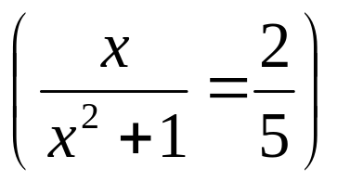
Example
Let the existentially quantified statement is
∃x
Domain of discourse is the set of real numbers.
Statement is true because it is possible to find at least one real number x to make the proposition true.

Slide 18
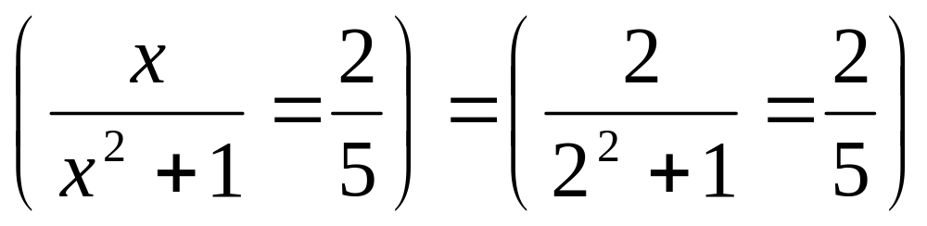
For example, if x = 2, we obtain the true proposition as below

Slide 19
Negation of Quantifiers
Distributing a negation operator across a quantifier changes a universal to an existential and vice versa.
¬ (∀x P(x)) ; ∃x ¬ P(x)
¬ (∃x P(x)) ; ∀x ¬ P(x)

Slide 20
Example
Let P(x) = x is taking Discrete Structure course with the domain of discourse is the set of all students.
  ∀x P(x): All students are taking Discrete Structure course.
  ∃x P(x): There is some students who are taking Discrete Structure course.

Slide 21
¬ (∃x P(x)) ; ∀x ¬ P(x)
  ¬∃x P(x): None of the students are taking Discrete Structure course.
  ∀x ¬ P(x): All students are not taking Discrete Structure course.

Slide 22
¬ (∀x P(x)) ; ∃x ¬ P(x)
  ¬∀x P(x): Not all students are taking Discrete Structure course.
  ∃x ¬P(x): There is some students who are not taking Discrete Structure course

Slide 23
Translating from English
Consider “For every student in this class, that student has studied calculus”
Rephrased: “For every student x in this class, x has studied calculus”
  Let C(x) be “x has studied calculus”
  Let S(x) be “x is a student”
∀x C(x)
  True if the universe of discourse is all students in this class

Slide 24
Translating from English 2
What about if the unvierse of discourse is all students (or all people?)
  ∀x (S(x)∧C(x))
    This is wrong! Why? (because this statement says that all people are students in this and have studied calculus)
  ∀x (S(x)→C(x))

Slide 25
Translating from English 3
Consider:
  “Some students have visited Mexico”
  “Every student in this class has visited Canada or Mexico”
Let:
  S(x) be “x is a student in this class”
  M(x) be “x has visited Mexico”
  C(x) be “x has visited Canada”

Slide 26
Translating from English 4
Consider: “Some students have visited Mexico”
  Rephrasing: “There exists a student who has visited Mexico”
∃x M(x)
  True if the universe of discourse is all students
What about if the universe of discourse is all people?
  ∃x (S(x) ∧ M(x))
  ∃x (S(x) → M(x))
    This is wrong! Why?
    suppose someone not in the class = F->T or F->F, both make the statement true

Slide 27
Translating from English 5
Consider: “Every student in this class has visited Canada or Mexico”
∀x (M(x)∨C(x)
  When the universe of discourse is all students
∀x (S(x)→(M(x)∨C(x))
  When the universe of discourse is all people

Slide 28
Proof Techniques
Mathematical systems consists:
- Axioms: assumed to be true.
- Definitions: used to create new concepts.
- Undefined terms: some terms that are not explicitly defined.
- Theorem

Slide 29
Proof Techniques
Theorem
  Statement that can be shown to be true (under certain conditions)
  Typically stated in one of three ways:
    As Facts
    As Implications
    As Bi-implications

Slide 30
Proof Techniques (cont.)
Direct Proof (Direct Method)
Proof of those theorems that can be expressed in the form ∀x (P(x) → Q(x)), D is the domain of discourse.
Select a particular, but arbitrarily chosen, member a of the domain D.
Show that the statement P(a) → Q(a) is true. (Assume that P(a) is true).
Show that Q(a) is true.
By the rule of Universal Generalization (UG),
  ∀x (P(x) → Q(x)) is true.

Slide 31
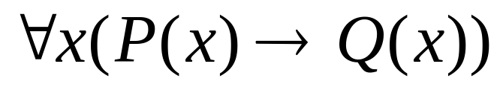
Example
For all integer x, if x is odd, then x² is odd
Or P(x) = is an odd integer
    Q(x) = x² is an odd integer
the domain of discourse is set Z of all integer.
Can verify the theorem for certain value of x.
  x=3, x² =9 ; odd

Slide 32
Example
Or show that the square of an odd number is an odd number
Rephrased: if n is odd, the n² is odd

Slide 33
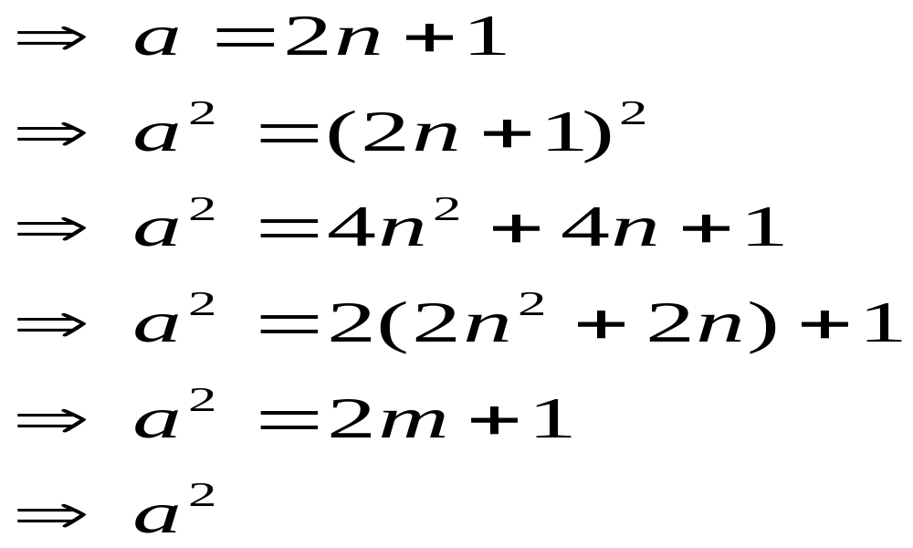
Example (cont.)
a is an odd integer
for some integer n
where m= 2n² + 2n is an integer
is an odd integer

Slide 34
Proof Techniques (cont.)
Indirect Proof
  The implication p → q is equivalent to the implication (¬q → ¬p) (contrapositive)
  Therefore, in order to show that p → q is true, one can also show that the implication (¬q → ¬p) is true.
  To show that (¬ q → ¬ p) is true, assume that the negation of q is true and prove that the negation of p is true.

Slide 35
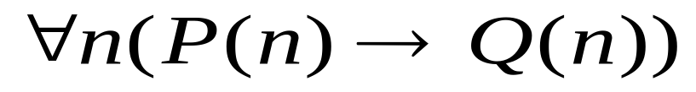
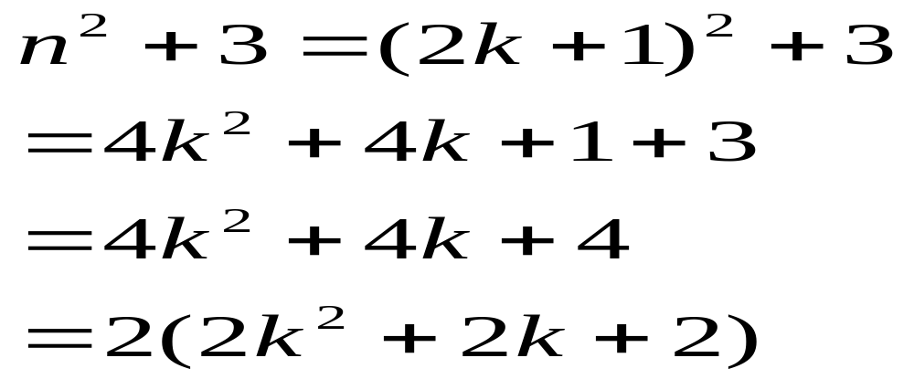
Example
P(n) : n²+3 is an odd number
Q(n) : n is even number
¬ Q(n) is true , n is not even (n is odd), so n=2k+1

Slide 36
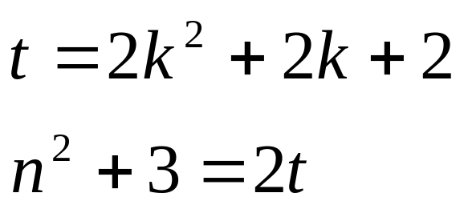
Example (cont.)
t is integer
n²+3 is an even integer, thus ¬ P(n) is true

Slide 37
Which to use
When do you use a direct proof versus an indirect proof?
If it’s not clear from the problem, try direct first, then indirect second
  If indirect fails, try the other proofs

Slide 38

Example of which to use
  Prove that if n is an integer and n³+5 is odd, then n is even
Via direct proof
  n³+5 = 2k+1 for some integer k (definition of odd numbers)
  n³ = 2k+6
  Umm…
So direct proof didn’t work out. Next up: indirect proof

Slide 39
Example of which to use
  Prove that if n is an integer and n³+5 is odd, then n is even
Via indirect proof
  Contrapositive: If n is odd, then n³+5 is even
  Assume n is odd, and show that n³+5 is even
  n=2k+1 for some integer k (definition of odd numbers)
  n³+5 = (2k+1)³+5 = 8k³+12k²+6k+6 = 2(4k³+6k²+3k+3)
  As 2(4k³+6k²+3k+3) is 2 times an integer, it is even

Slide 40
Proof Techniques (cont.)
Proof by Contradiction
Assume that the hypothesis is true and that the conclusion is false and then, arrive at a contradiction.
Proposition if P then Q
Proof. Suppose P and ~Q
Since we have a contradiction, it must be that Q is true

Slide 41
Example
Prove that there are infinitely many prime numbers.
Proof:
Assume there are not infinitely many prime numbers, therefore they are can be listed, i.e. p₁,p₂,…,p_{n}
Consider the number q = p₁ x p₂ x…x p_{n} + 1.
q is either prime or not divisible, but not listed above. Therefore, q is a prime. However, it was not listed.
Contradiction! Therefore, there are infinitely many primes numbers.

Slide 42
Example
For all real numbers x and y, if x+y ≥2, then either x ≥ 1 or y ≥ 1.
Proof
Suppose that the conclusion is false. Then
  x < 1 and y <1
  Add these inequalities, x+y < 1+1 = 2 (x+y <2)
Contradiction
Thus we conclude that the statement is true.

Slide 43



Example
Suppose . If is even, then a is even
Proof
Contradiction: Suppose is even and a is not even.
Then is even, and a is odd
So , then
Thus is even and is not even, a contradiction
The original supposition that is even and a is odd could not be true

